Slide 1

Resource Mobilisation for School Feeding Programme:
Improving Effectiveness
Umar Abdullahi Yaro

Slide 2
Resource Mobilisation
Resource Mobilisation is:
The process of obtaining the resources you need to implement your planned activities (UNESCO).
A process where we identify the resources essential for the development, implementation, and continuation of works for achieving the organization’s mission.
Focused on the relationship with Resource Providers, the skills, knowledge, and capacity for proper use of resources.
Resource Mobilisation is described as an organization’s efforts to attract resources.

Slide 3
What is Resource Mobilisation for School Feeding Programme and why do you need it?

Slide 4

Resource Mobilization for School Feeding Programme
Involves garnering financial, human, and material resources from various sources to ensure the sustainability and effectiveness of these programs.

Slide 5
Difference Between Resource Mobilisation and Fundraising

Slide 6
Resource Mobilisation goes beyond fundraising, it is friend-raising as well.
Resource mobilisation
Resource mobilisation often focused on generating funds . However, it must include building valuable contacts and networks. Also Earning the interest, support and in-kind contribution of people important to your organisation.
Fundraising
Fundraising is the process of collecting money as donations, for a cause from individuals, Governments, and businesses.

Slide 7
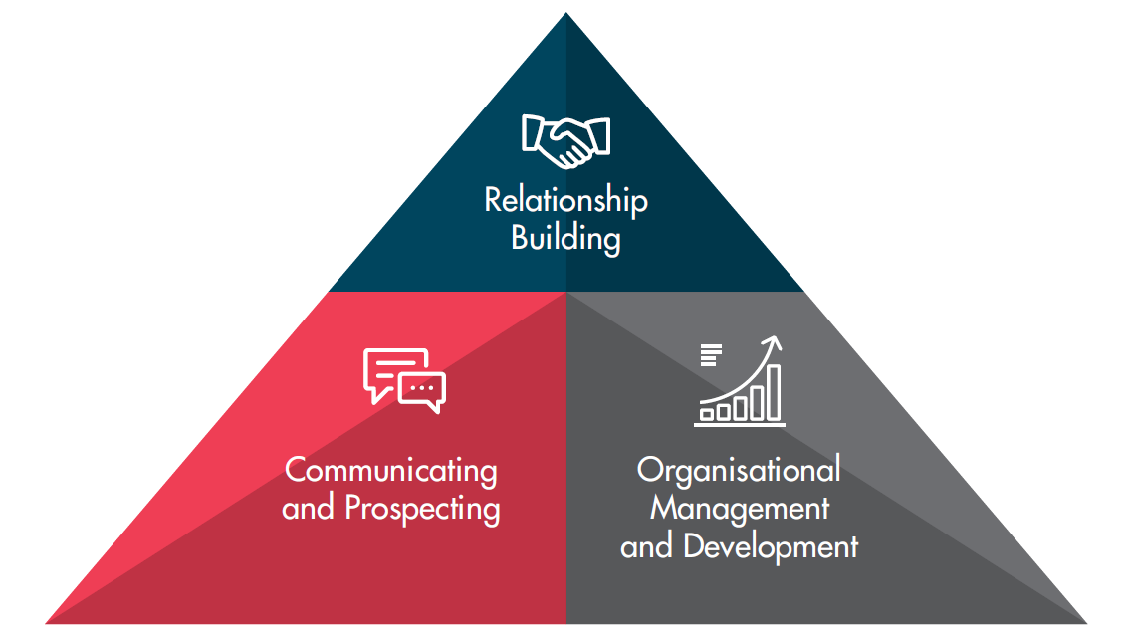
ELEMENTS OF RESOURCE MOBILISATION

Slide 8
ELEMENTS OF RESOURCE MOBILISATION
Organisational management and development involve establishing and strengthening your organization. This involves identifying your organization’s vision, mission, and goals, and putting in place internal systems and processes that enable resource mobilization efforts. They include identifying the roles of the board and staff in the process as well as effectively and efficiently managing human, material, and financial resources..
Resource mobilization is to a large extent connecting to resource partners in a relatable manner and exploring shared values and interests. This also includes identifying the right resource partners and to approach them with tools and messages that meet their interests. Your organization should keep in mind that financial support is a direct result of a relationship built between people.
The key elements of relationship building are consistent communication, a strong connection to your cause, and trust building. Awareness and trust can only be built through sustainable communication. Experience has shown that dialogue is more successful than monologue. For resource mobilization to be successful, your organisation must succeed in building a trusting relationship with your resource partners through dialogue.

Slide 9
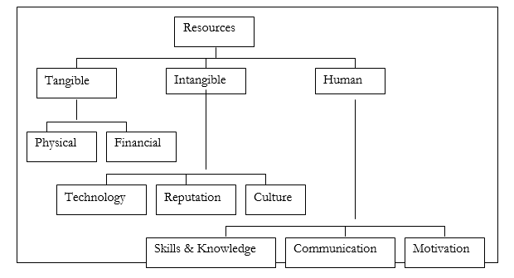
RESOURCE MOBILISATION PROCESS
1. Resource Mapping
2. Donor Landscaping
3. Donor Mapping
4. Donor Approach
5. Obtain Resources
6. Evaluate

Slide 10
RESOURCE MAPPING
Identify different types of resources needed in your state :
Supply or support from within or outside the organization needed to meet objectives
Classify your resources into :
Financial, Human, Material or Technical resource
Knowing which of these and in what quantity your organization will require over a period is the first step in resource mobilization

Slide 11
…….. RESOURCE MAPPING
Take Inventory of Current and Future Resources
Having identified the different resources needed for the project, it is important the organization take stock of what is available and what is required.
Identify the resource gaps, so you focus on how to address the gap and who or what organization to approach to meet the gap.
RESOURCE MAPPING

Slide 12
Donor Landscaping
The process of identifying, analyzing, and categorizing potential donors to understand their interests, giving capacity, and alignment with your organization’s goals. This helps in creating targeted strategies to engage with donors and secure funding.
Goal: Understand potential donors and their giving patterns to effectively target fundraising efforts.
Scope: Identify individual donors, corporate donors, foundations, and government sources.
Identify Potential Donors
Existing Donors: Analyze current donors to understand their motivations and giving capacity.
New Prospects: Identify potential new donors through research and networking.
Categorize Donors
Individuals: High-net-worth individuals (HNWIs), philanthropists, and community leaders.
Corporations: Businesses with CSR programs, industry leaders, and local businesses.
Foundations: Private foundations, family foundations, and corporate foundations.
Government: National, regional, and local government funding opportunities.

Slide 13
…….Donor Landscaping
Research Donors
Background Information: Gather information on the donor’s history, mission, and giving patterns.
Funding Interests: Identify the donor’s areas of interest and priority sectors.
Giving Capacity: Estimate the donor’s potential financial contribution.
Previous Giving: Look at past donations to similar causes or organizations.
Analyze Donor Alignment
Mission Alignment: Assess how well the donor’s mission aligns with your organization’s goals.
Interest Match: Identify specific programs or projects that match the donor’s interests.
Engagement Potential: Evaluate the likelihood of building a long-term relationship with the donor.
Develop Engagement Strategies
Tailored Approach: Develop personalized engagement strategies based on donor profiles.
Individuals: Personal meetings, exclusive events, recognition programs.
Corporations: CSR partnerships, employee engagement programs, sponsorship opportunities.
Foundations: Detailed proposals, highlighting alignment with funding priorities, impact reports.
Government: Compliance with application requirements, demonstrating policy alignment, showcasing impact.

Slide 14
Donor Mapping
The process of visually and systematically organizing information about potential and existing donors. This helps in identifying and understanding donor characteristics, preferences, and relationships, which can enhance fundraising strategies and efforts.
Gather Information: Existing Donors or Potential Donors
Categorize Donors: Individuals, Corporations, Foundations or Government
Create Donor Profiles: Name, Contact, Information, Background and Mission, Areas of Interest, Past Giving History, Giving Capacity, Preferred Type of Support, etc.

Slide 15
Example Donor Map
Donor Type | Donor Name | Interest Area | Giving Capacity | Engagement Level | Preferred Support | Relationship
Individual | Usman Bello | Education | High | High | Major gifts | Long-term supporter
Corporation | ABC Corp | Community Health | Medium | Medium | CSR sponsorship | CSR partner
Foundation | XYZ Foundation | Child Welfare | High | Low | Grants | Potential funder
Government | Local Govt | School Programs | Medium | High | Grants | Ongoing partner

Slide 16
Donor Approach
Requires a strategic and personalized plan to build relationships, demonstrate alignment with their interests, and secure their support.
Engage, Negotiate, Manage and Report, Communicate Result
Initial Contact
Building the Relationship
Proposal Presentation
Follow-Up
Recognition and Acknowledgment

Slide 17
Obtain Resources
Clear Communication: Clearly articulate the need and impact of resources to potential donors and supporters.
Regular Updates: Keep donors informed about the progress and impact of their contributions.
Building Relationships: Focus on building long-term relationships with donors, partners, and volunteers.
Transparency: Be transparent about how resources are used and the outcomes achieved.

Slide 18
Evaluate
Evaluating the effectiveness of your resource mobilization efforts is crucial for understanding their impact, identifying areas for improvement, and ensuring accountability to stakeholders.
Define Evaluation Objectives - SCOPE
Establish Evaluation Criteria and Indicators
Collect Data
Analyze Data
Report Findings (Internal & External)
Make Recommendations and Adjustments
Continuous Improvement

Slide 19


