Slide 1
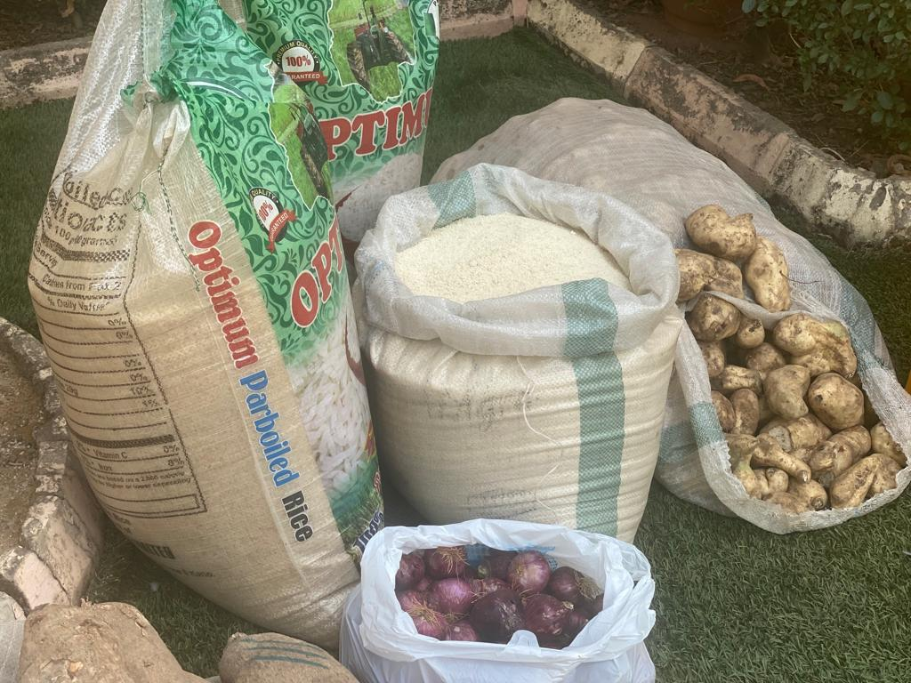
Utilizing School Gardens as a Tool to Improve Food Security Systems in Communities through School Feeding Programs
Ifedinma Nwigwe
Maple Leaf Early Years Foundation​

Slide 2
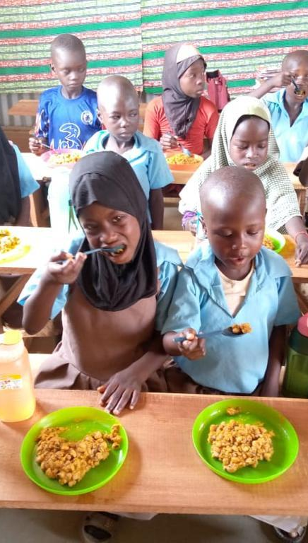
Introduction
With the current economic situation biting everyone hard, and the cost of food skyrocketing this is one of the times to think outside the box
We are already aware of the benefits of a functional SFP that works for the beneficiaries and by extension the communities
How can we involve communities and why is it necessary?

Slide 3
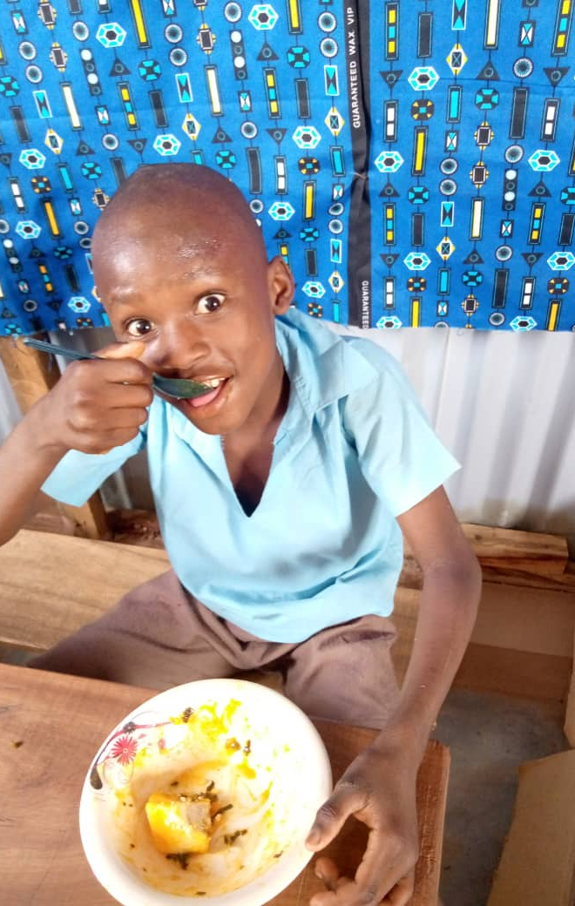
Importance of Food security systems
Basic human right
Economic stability
Health and Nutrition
Poverty reduction
Global security
Sustainable development
Notes:
The UN recognizes the right to food as a fundamental human right, emphasizing that everyone should have access to safe and nutritious food
In countries like Yemen and Afghanistan, food security initiatives have helped stabilize local economies by ensuring that people have access to food, which in turn supports local markets and reduces the risk of economic collapse
The Scaling-Up Nutrition Movement has linked nutrition to agriculture, clean water, sanitation, education and healthcare significantly improving the health and nutrition sstatus of communities in countries like Malawi and Nepal
In Ghana, school feeding programs have been shown to reduce poverty by providing children with meals, which alleviates the financial burden on families and allows them to allocate resources to other needs
Food security is crucial for global stability. For instance, during the 2007-2008 global food crisis, food shortages led to riots and political instability in over 30 countries, highlighting the link between food security and global peace
The UN SDG Goal 2 aims to end hunger, achieve food security, and promote sustainable agriculture by 2030. Initiatives like the Zero Hunger Challenge have garnered global support to achieve these goals.

Slide 4


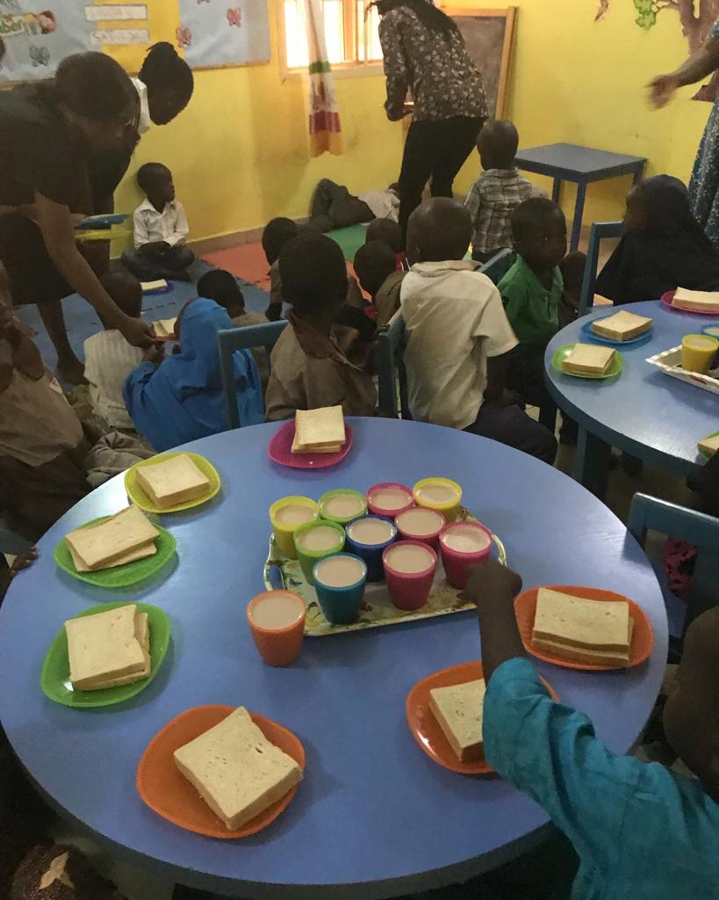



Importance of SFPs
Educational benefits
In Brazil, the National SFP significantly improved student attendance and performance by providing daily meals to over 40 million students
Health and Nutrition
In Kenya, the Home-Grown SFP sources food locally, improving the nutritional status of children while supporting local farmers
Community Support
In Malawi, community involvement in SFPs has led to increased local support and participation, fostering a sense of ownership and responsibility among community members
Safety net
Here in Nigeria, SFPs act as a safety net for vulnerable families, ensuring that children receive at least one nutritious meal a day, which is crucial during these times of economic hardship
Gender Equality
In Bangladesh, SFPs have helped increase the enrollment and retention of girls in school, contributing to gender equality in education

Slide 5
School feeding programs are not just about filling bellies; they are about nourishing futures and building stronger communities.
“
”
Michelle Obama

Slide 6
How can communities get involved?
Partnering with local farmers
Schools can collaborate with local farmers to supply fresh produce for school meals.
This not only ensures a steady supply of nutritious food but also supports local agriculture and economies.
Community/School gardens
Establishing community/school gardens where residents/students grow foods specifically for school feeding programs.
This promotes community involvement and provides fresh, healthy food for students.
Integrate school gardens into the curriculum

Slide 7
Integrating School Gardens into the School Curriculum
Science
Plant life cycles
Soil studies
Weather & climate
Social Studies
History of agriculture
Community involvement
Environmental Education
Sustainability
biodiversity
Mathematics
Measurement & data
Geometry
Art
Drawing and painting
Life Skills
Responsibility
Problem-solving
Language
Write about the garden
Reading books related to gardening, nature and school feeding
Health & Nutrition
Healthy eating
Cooking classes

Slide 8
Types of School Gardens
Greenhouse gardening
  Controlled climate allows year-round gardening
  Protection from extreme weather and pests
Vertical gardening
Plants are grown on vertically suspended panels or structures
Maximizes space for small areas
May need specialized irrigation systems
Traditional In-Ground Gardening
Cost-effective
Easy to start
Utilizes natural soil
Suitable for large spaces
Container gardening
  Flexible & portable
  Ideal for small spaces
  Can be used indoors
Raised Bed gardening
  Grown in soil-filled beds raised above ground level
  Better control over soil quality and drainage
  Easier access for planting and maintenance

Slide 9
Why School Gardens?
ENHANCED LEARNING
NUTRITIONAL AWARENESS
COMMUNITY ENGAGEMENT
School gardens provide hands-on learning opportunities across various subjects, such as science, math, and environmental studies. This practical approach helps students better understand and retain academic concepts.
By growing their own foods, fruits and vegetables, students learn about healthy eating habits and the importance of nutrition. This can lead to increased consumption of fresh produce and improved dietary choices.
School gardens can serve as a hub for community involvement, bringing together students, parents, teachers, and local residents. This strengthens community bonds and encourages teamwork and collaboration.

Slide 10
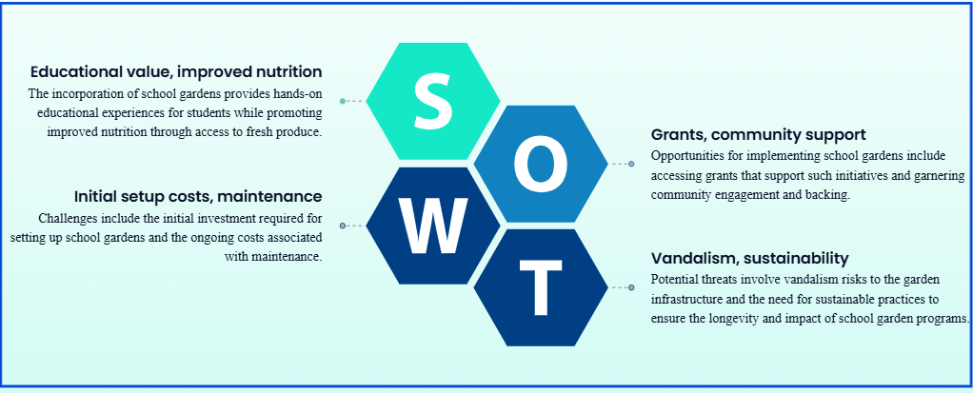
STRENGTHS, WEAKNESSES, OPPORTUNITIES, THREATS

Slide 11
What can be done?
Mitigating Weaknesses
Mitigating threats
Seek grants and donations from local businesses and community organizations
Use greenhouses or indoor gardening to extend the growing season and plan year-round activities like composting
Provide training and professional development around planting and agricultural practices for teachers and staff
Partner with local agricultural experts for guidance
Install fencing and engage the community to foster a sense of ownership and responsibility for the garden
Implement integrated pest control practices and educate students on pest prevention techniques
Develop long term plans with the community and the local government such as fundraising events and partnerships

Slide 12
Monitoring and Evaluation
Methods
Key Performance Indicators (KPIs)
Student engagement – track attendance
Nutritional outcomes – track changes in consumption of garden produce
Academic performance – compare academic records before and after the garden implementation
Community involvement – track level of community participation and support for the school garden
Environmental awareness – evaluate changes in environmental literacy
Surveys and questionnaires, from students, teachers and the community
Observations and documentation
Academic performance by measuring the impact of garden-based learning on academic performance
Health and nutrition assessments such as body measurements
interviews

Slide 13

Summary
School gardens are a powerful tool for enhancing education, promoting health, and building stronger communities.
Integrating gardens into the curriculum not only enriches their academic learning but also promotes physical activity, mental well-being and environmental stewardship, as well as healthy living and community engagement.
Implementing school gardens can be highly beneficial, and with careful planning and community involvement, the challenges can be effectively managed.

Slide 14
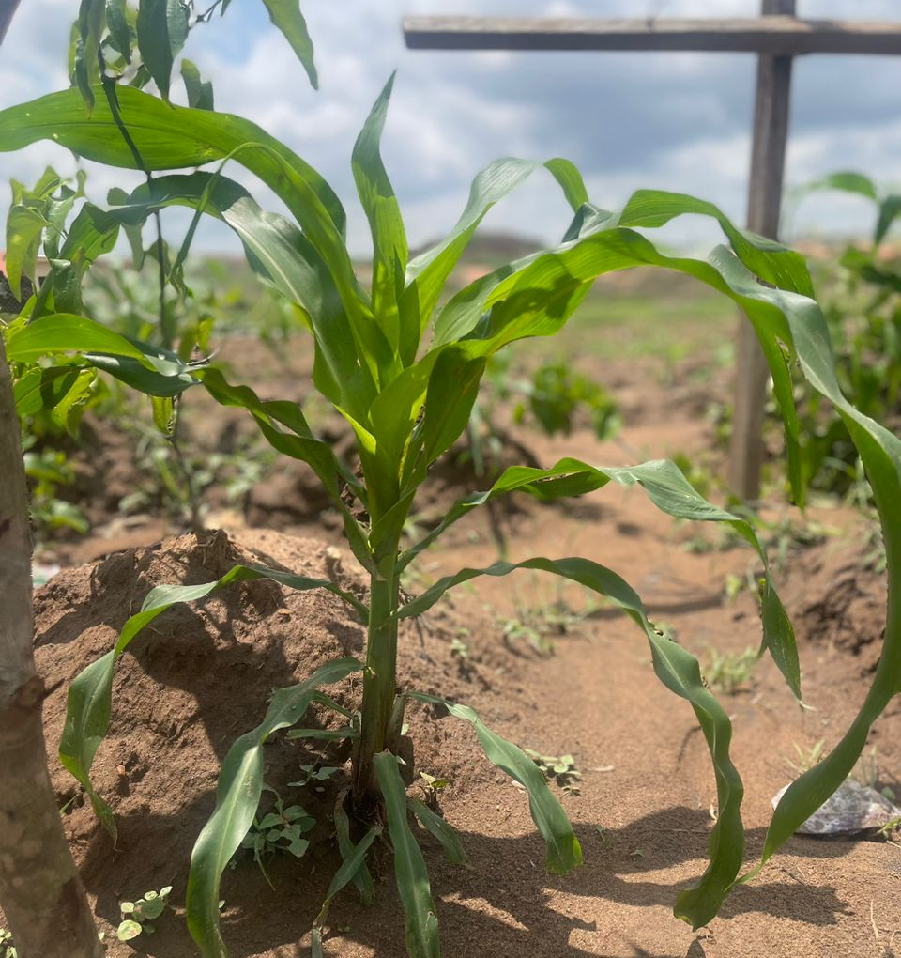
Thank you
Ifedinma Nwigwe
ify.nwigwe@mleyfoundation.org
www.mleyfoundation.org

